Slide 1

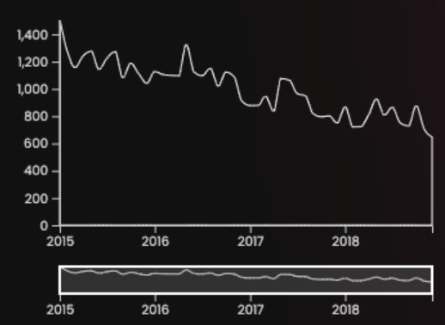
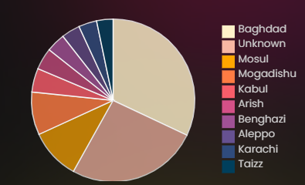
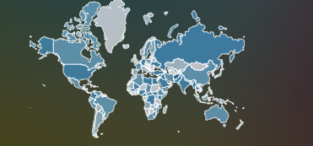
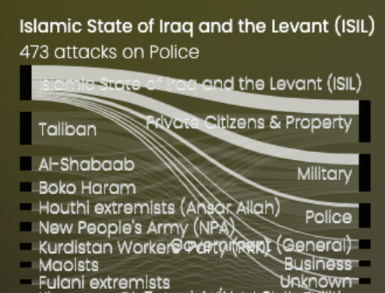
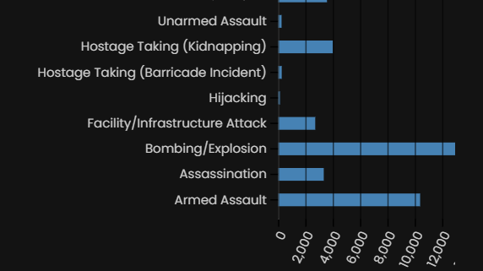
Abhinav Minocha
Group - 44
GLOBAL TERRORISM DASHBOARD ANALYSIS PROJECT
Plots
Pie Chart
The pie chart in my dashboard represents the top 10 worst affected cities with respect to the country selected in the map. The choropleth map and pie chart are both interactive with each other.
Introduction
chart represents the time series of attacks between years 2015 to 2018 for respective country selected in the choropleth map.
The main objective for doing this project is to build a dashboard to identify the trends, patterns and some interesting insights of the global terrorism activities with the help of the visualization, analyze the effects of these changes on various other factors of the society to produce interesting, statistically significant results that can be used for tackling the horrors of global terrorism.
Choropleth Map
The geographic information in the dataset of the longitude and the latitude about the event is used to represent the event on a map. This method of visual representation helps the user to understand the exact geographic location of the event. Further, a map of a country is used to represent the state-wise distribution of the terror events. Shades of blue are used to represent the intensity of the attacks in a specific country. The map is as shown below:
Data Insights & Findings
The countries such as Iraq, Iran, Syria Afghanistan, Yemen faced the greatest number of terrorists attacks between the years 2015 – 2018 based on the size.
The top 3 attacks across all regions were: Bombing/Explosion, Armed Assault and Hostage Taking.
The terrorist organizations named ISIL(Islamic State of Iraq and Levant), Taliban and Boko Haram has carried out the greatest number of terrorist attacks across the world.
The most affected types of targets for majority of the countries has been Military and Private Citizens & Property.
The top 5 cities affected with terrorist's attacks has been: Baghdad, Mosul, Mogadishu, Kabul and Arish.
Sankey Chart
A Sankey diagram helps to visualize the flows from one set of values to another. In my current implementation of Sankey graph, the flow is visualized between the terrorist organization and the targets of them. The graph is as shown below:
Dataset Description
The GTD (Global Terrorism Database) is an open-source database, which provides information on domestic and international terrorist attacks around the world since 1970. The current dataset has information records for all the domestic and international terrorist attacks since year 2015 – 2018 which has been analyzed via various visualization graphs. I have analyzed the overall geographic distribution of the terrorist attacks, along with the organizations involved behind those attacks, and the time series of a particular attack.
Bar Chart
The bar chart in my dashboard represents the type of attack which was involved, and how many total attacks which has taken place with respect to its type.
Conclusion
Time Series Chart
The time series chart illustrates the data points at successive intervals of time. In my current visualization, time series
The visualization help us achieve interesting analysis and some meaningful, statistically significant results from global terrorism analysis that can be used in the real world to help governments of every country to educate people and form counter terrorism policies.

